Slide 1
Craft DEMo
PAVED ROAD

Slide 2

About ME
DHANANJAY

Slide 3
Introduction TO PROBLEM
To Create Repo Initializer with added benefits of
Themes
CI/CD configuration

Slide 4
Problem STATEMENT
Java Paved Road is an application that provides a streamlined, no-code wizard to create java applications from pre-defined template(s). The two functionalities that it provides are
Create a Java Library
Create a Java Web Service (based on spring ecosystem)
To provide the best experience to Java developers, it is important that the resulting code should be ready to be used.

Slide 5
Understanding the Problem
Lack of Efficiency: Developers are spending excessive time on setup tasks, hindering productivity.
Inconsistent Quality: Manual processes can lead to variations in code quality and maintainability.
Steep Learning Curve: New developers might struggle with understanding complex build and deployment processes.

Slide 6

PEOPLE
Target Audience: Primarily Java developers, ranging from beginners to experienced professionals.
User Experience (UX): Design an intuitive and user-friendly interface that guides users through the process.
Community Engagement: Foster a community around the platform to share knowledge, provide feedback, and contribute to improvements.

Slide 7
Solution Objectives
Simplify Project Creation: Provide a user-friendly, no-code interface for creating Java libraries and web services.
01
Ensure Code Quality: Generate high-quality, production-ready code based on best practices.
02
Accelerate Development: Reduce the time it takes to start new projects.
03

Slide 8
Key Features for Java Paved Road
Template Library: A curated collection of pre-defined templates for various Java application types (e.g., web services, libraries).
Code Generation: Automatically generate code based on selected templates and user inputs.
Project Structure: Create a well-structured project directory with necessary files and configurations.
Build and Deployment Configuration: Configure build tools (e.g., Maven, Gradle) and deployment options (e.g., JAR, WAR).
Integration with CI/CD: Provide options to integrate with popular CI/CD tools.
Documentation and Tutorials: Offer comprehensive documentation and tutorials to guide users through the platform.

Slide 9
Key Features for Java Paved Road
Template Library: A curated collection of pre-defined templates for various Java application types (e.g., web services, libraries).
Code Generation: Automatically generate code based on selected templates and user inputs.
Project Structure: Create a well-structured project directory with necessary files and configurations.
Build and Deployment Configuration: Configure build tools (e.g., Maven, Gradle) and deployment options (e.g., JAR, WAR).
Integration with CI/CD: Provide options to integrate with popular CI/CD tools.
Documentation and Tutorials: Offer comprehensive documentation and tutorials to guide users through the platform.

Slide 10
Template Engine Thyme leaf
PROS
CONS
HTML-based templates: Uses HTML syntax, making it familiar to web developers.
Natural template syntax: Provides a natural and expressive syntax for creating templates.
Integration with Spring ecosystem: Seamlessly integrates with Spring MVC and other Spring components.
Can be less performant than pure Java templates: While Thymeleaf is efficient, it might be slightly less performant than pure Java templates in certain scenarios

Slide 11
Template Engine Free Marker
PROS
CONS
Powerful template language: Provides a flexible and expressive language for creating complex templates.
Flexible syntax: Offers a variety of syntax options to suit different coding styles.
Integration with various frameworks: Can be used with a wide range of frameworks, including Spring, Java EE, and more
Can be more complex to learn than simpler options: The powerful features of FreeMarker might require a steeper learning curve.

Slide 12
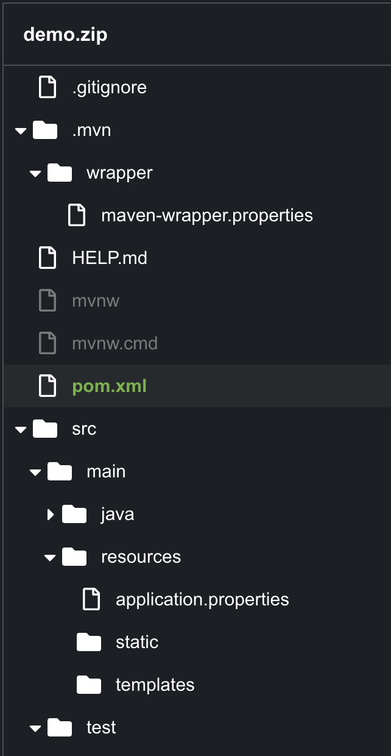
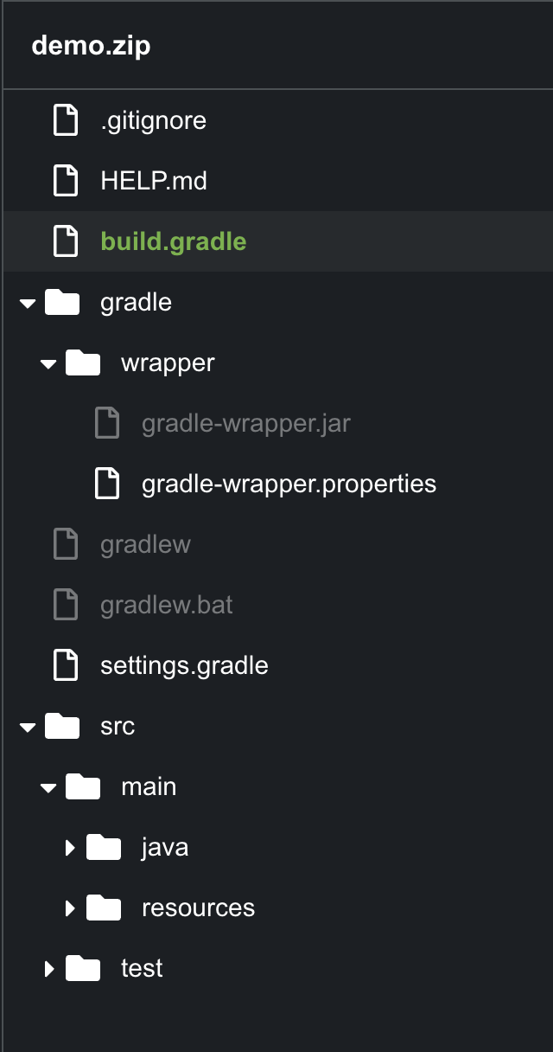
Code STRUCTURE

Slide 13
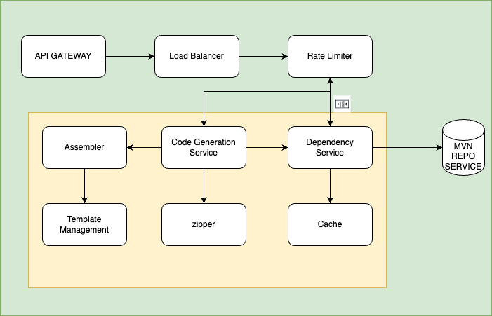
HIGH LEVEL FLOW

Slide 14
Class Hierarchy -1

Slide 15
Class HIERARCHY - 2

Slide 16

Demo & Code Walk Through

